Slide 1

Green Pace
Security Policy Presentation
Developer: Nicholas Davis

Slide 2

OVERVIEW: DEFENSE IN DEPTH
This policy will highlight the main security principles, C++ coding standards, and Triple A standards. These standards enable the practice of Defense in Depth and the creation of a secure system.

Slide 3
THREATS MATRIX
Likely: Indicates high chance of threat | Priority: High probability to occur/ high impact
Low priority Low probability to occur/ low impact | Unlikely: Low chance of threat

Slide 4
10 PRINCIPLES
1. Validate Input Data
2. Heed Compiler Warnings
3. Architect and Design for Security Policies
4. Keep it Simple
5. Default Deny
6. Adhere to the Principle of Least Privilege
7. Sanitize Data Sent to Other Systems
8. Practice Defense in Depth
9. Use Effective Quality Assurance Techniques
10. Adopt a Secure Coding Standard

Slide 5
CODING STANDARDS
Do not write syntactically ambiguous declarations
Do not access an object outside of its lifetime
Do not attempt to create a std::string from a null pointer
Prevent SQL Injection
Detect and handle memory allocation errors
Use a static assertion to test the value of a constant expression
Do not abruptly terminate the program
Write constructor member initializers in the predefined order
Do not use std::rand() for generating pseudorandom numbers
Use valid iterator ranges

Slide 6
ENCRYPTION POLICIES
Encryption at rest - This refers to the process of securing data by encrypting it and ensuring it is stored in the storage system. It protects against unauthorized access, and data breaches. Allows for encryption algorithms and keys.
Encryption in flight - Encrypting data while it a transmitted over a network. This is understood to protect data from unauthorized access, or interception while it is being transmitted. It can protect the data and can be part of a compliance requirement. It uses key exchange for the sender and receiver. Decryption must also be utilized on the receiving end to see and restore the data.
Encryption in use - This means encrypting the data as it is being used or processed. This protects data as it is currently being used either in memory or on an application. It allows for usage of the data while it remains encrypted, so it is not vulnerable. It will provide enhanced security and reduce the risk of data breaches.

Slide 7
TRIPLE-A POLICIES
Authentication - This process of verifying a user and ensuring they have access. Can be utilized with password authentication, MFA, and/or biometric authentication. Providing better security and greater access control.
Authorization - After the user has been authenticated it will assess what that user has permission to access. This will assign specific permissions and rights to certain resources based on what the user can or should be able to access.
Accounting - Accounting involves the tracking of a user and their activity to include what data they have or should access, and how long. It can track and audit a user’s actions, detect suspect activity, and log this information. This can enhance security analysis to better understand system history.

Slide 8
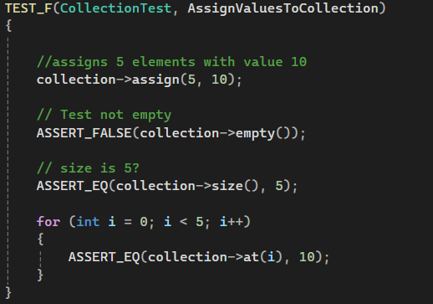
AssignValuesToCollection

Slide 9
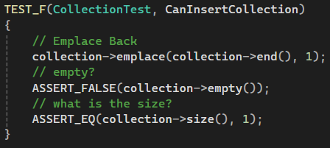
CanInsertCollection

Slide 10
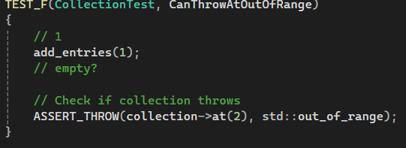
CanThrowAtOutOfRange

Slide 11
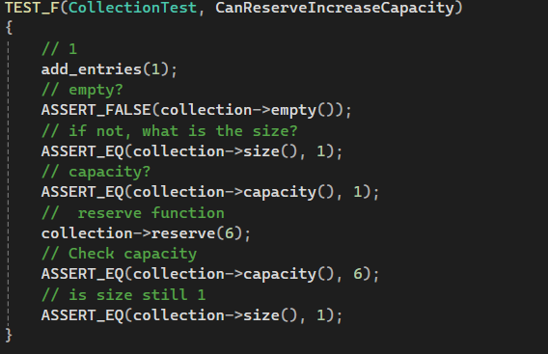
CanReserveIncreaseCapacity

Slide 12

AUTOMATION SUMMARY
Automation will be implemented to highlight vulnerabilities and standards of policy.

Slide 13
TOOLS
The DevSecOps Pipleline is to integrate security into every phase of the software development lifecycle.
External Tools:
Parasoft C/C++ test – This is used during the design and test stage prior to production, and in the maintenance stage for postproduction.
Astree – Used to prove absence of runtime errors, through runtime error detection
LDRA tool Suite – Test automation framework, for software verification, requirements management, detection of defects in coding standards.
Clang – Provides static analysis to identify bugs, vulnerabilities by analyzing source code
Polyspace Bug Finder – Identifies runtime errors, security vulnerabilities, memory errors, and concurrency issues.

Slide 14
RISKS AND BENEFITS
Pros–
Ability to prevent future attacks
Greater defense in depth upfront
Implementation can be done easier if done initially
Cons-
Cost upfront
Adds complexity to system
More time and expertise required to accomplish

Slide 15
RECOMMENDATIONS
Utilization of tool policy - Identify and implement the correct tools for specific jobs/phases of production.
Pre-Production Policy – Sources and repositories need to be identified and utilized in the pre-production phase in order to provide proper security for later phases.
Post-Production Policy – Should vulnerabilities arise, clear actions need to be identified and implemented according to the nature of the issue, this will aid in concise and timely repairs.

Slide 16
CONCLUSIONS
Adopting a Secure Coding Standard - By adopting a secure coding standard, we are able to follow laid out guidelines and ensure coding is performed to the necessary standards. This can also include adhering to security principles and standards throughout the development lifecycle.
Keep it Simple - Keeping the scope of the design simple reduces errors in the software. This will allow you to minimize the complexity of security required of the system.
Architect and Design for Security Policies - Take architecture and design into consideration when building software as it relates to implementing security policies, such as separating a system into subsystems.

Slide 17
REFERENCES
SEI CERT C++ Coding Standard. https://wiki.sei.cmu.edu/confluence/pages/viewpage.action?pageId=88046682
Information Security Policies: Why They Are Important To Your Organization. https://linfordco.com/blog/information-security-policies/
Secure Coding: A Practical Guide. https://www.mend.io/blog/secure-coding/

